Slide 1


Slide 2



Xamarin in the Cloud

Slide 3

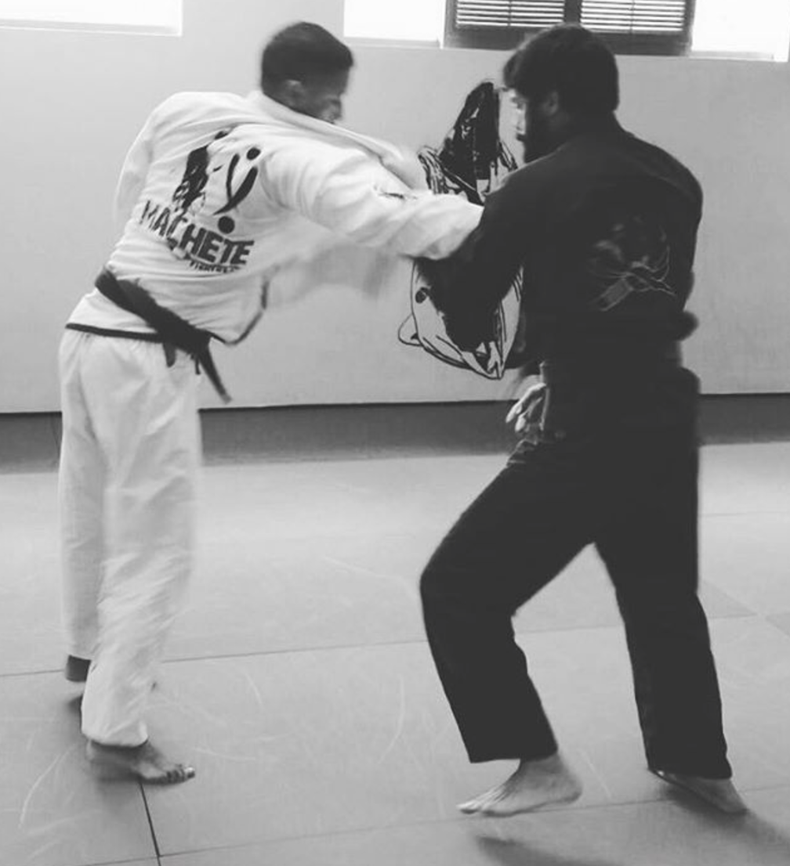


Hector Minaya
Megsoft Consulting
https://medium.com/@hminaya

Slide 4

Serie de Xamarin & Azure
Xamarin in the Cloud - I
Azure Mobile Backend
Azure Mobile SDK
Xamarin in the Cloud - II
Offline data caching
SyncServices
Xamarin in the Cloud - III
Security: Authentication & Authorization
info@megsoftconsulting.com

Slide 5
https://university.xamarin.com/
info@megsoftconsulting.com

Slide 6
info@megsoftconsulting.com

Slide 7
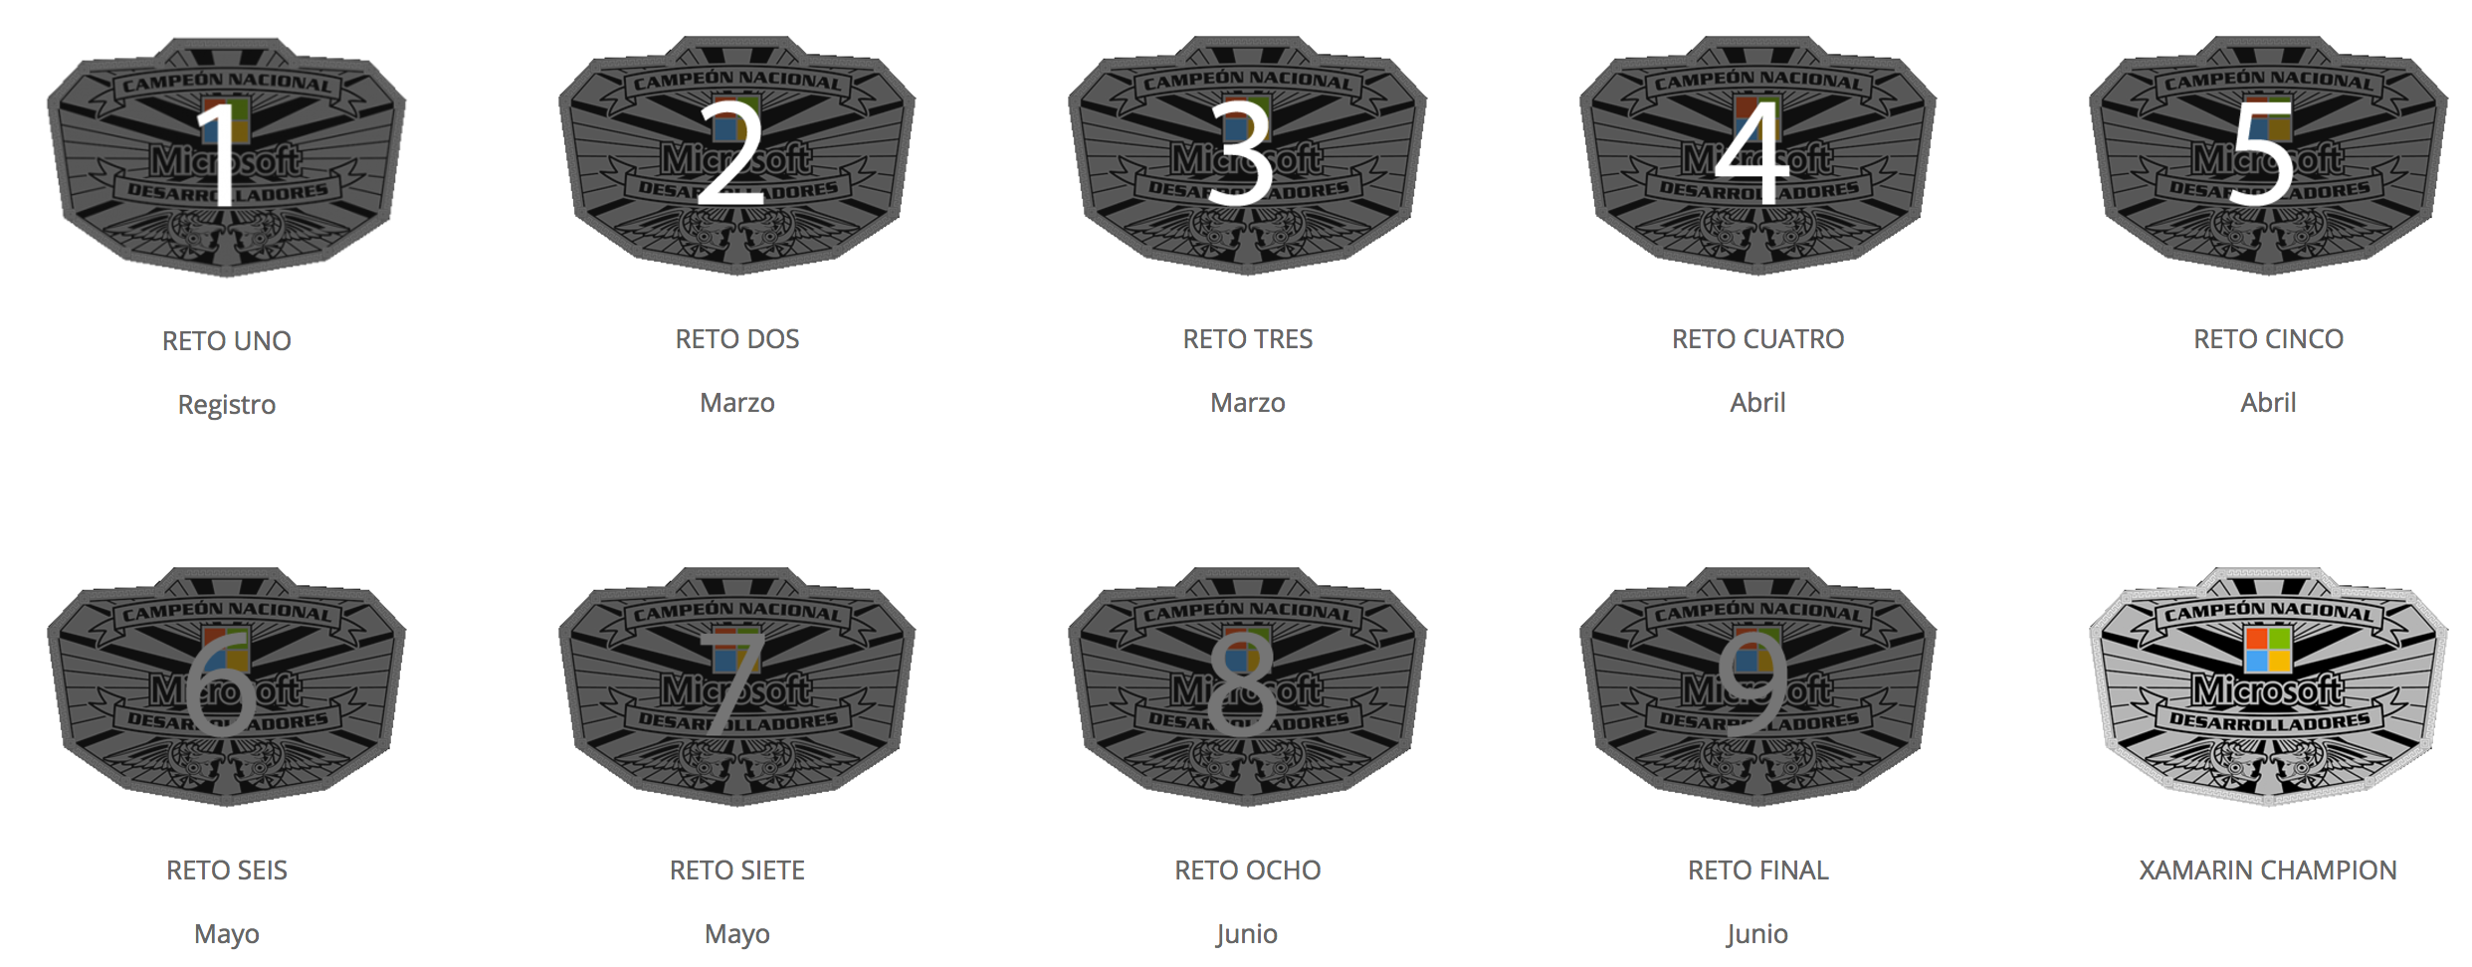
http://xamarinchampionship.azurewebsites.net/
info@megsoftconsulting.com

Slide 8
https://github.com/hminaya/XamarinInTheCloud
info@megsoftconsulting.com

Slide 9


